Slide 1
BUILDOTS UPDATE : 20/01/2020

Slide 2
SUMMARY
Try at using the 5k and 5.7K resolution from Garmin VIRB 360 (as opposed to 4K previously) so as to possibly increase the amount of feature points detected by Colmap.
Best 4 Camera models tested: SIMPLE_RADIAL_FISHEYE, RADIAL_FISHEYE, RADIAL, FOV
10/20 FPS comparison

Slide 3
GENERALS
4K recording was previously performed, the camera is stitching together front and back image to give an output video of 2880x2880[px] out of which we extracted only the center of 1100x500[px] in order to compare with the 5K
5K records separately 2 video (front/back) each of 2160x2160[px] with a 201.8° FOV
5.7K* records separately 2 video (front/back) each of 2880x2880[px] with a 201.8° FOV
*5.7K recording can only be activated through the Garmin VIRB mobile app

Slide 4
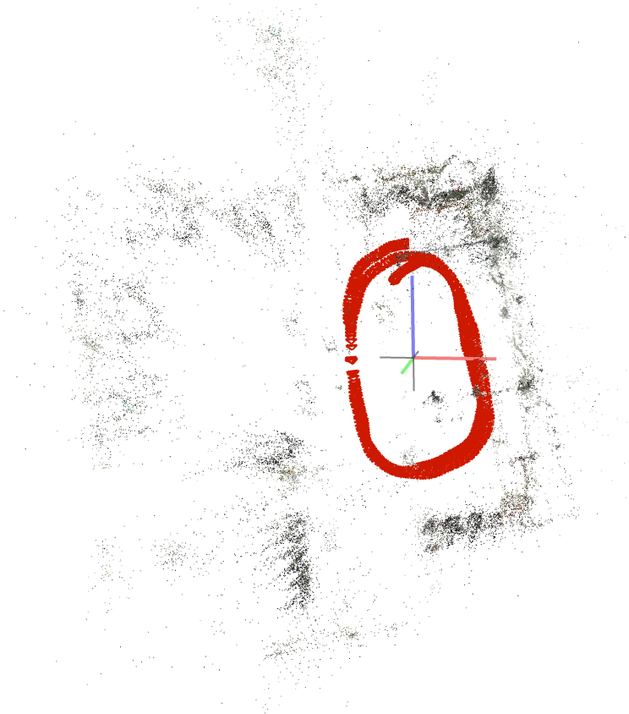
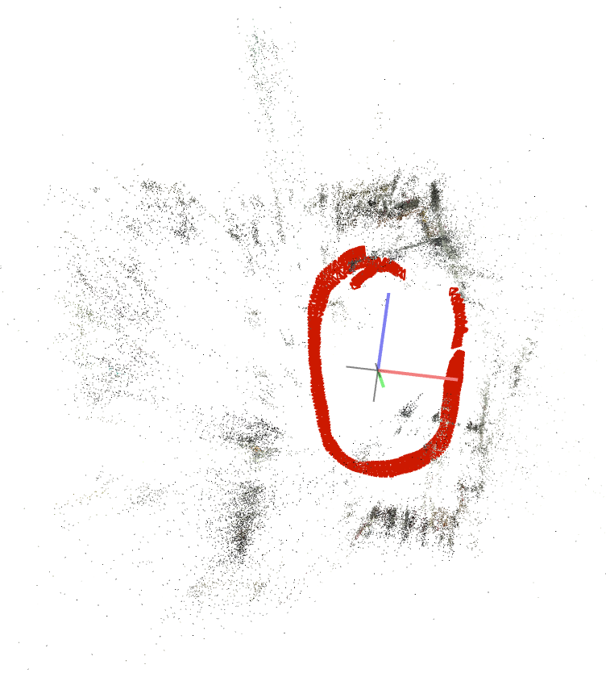
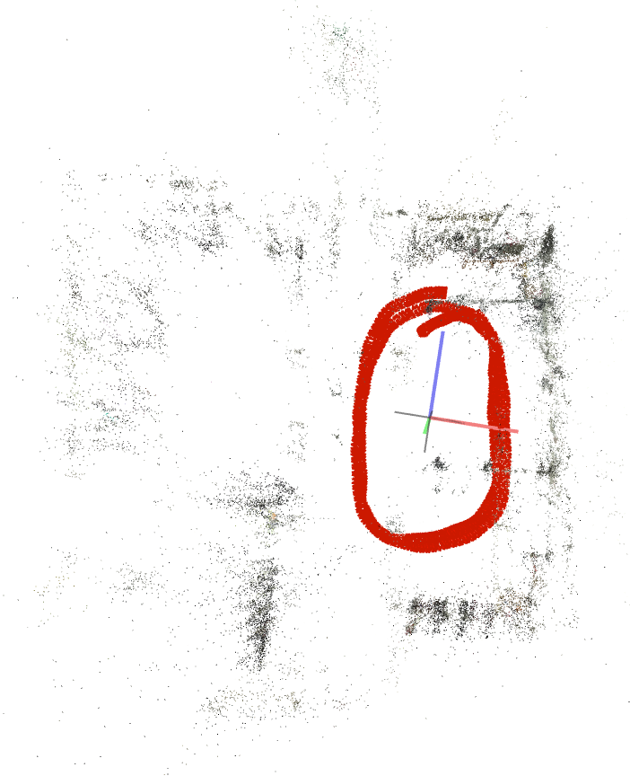
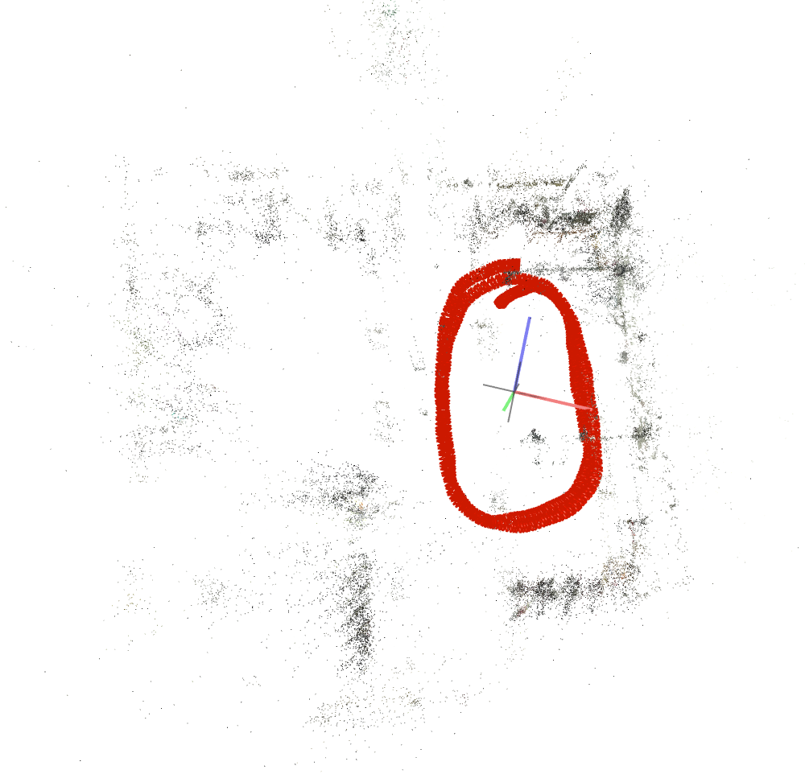
10 FPS 5K
SIMPLE_RADIAL_FISHEYE 1 Sparse model | SIMPLE_RADIAL 1 Sparse model | RADIAL 1 Sparse model | FOV 1 Sparse model

Slide 5
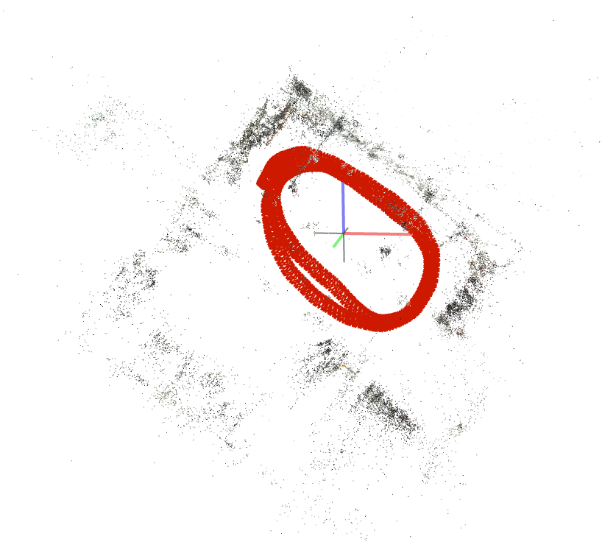
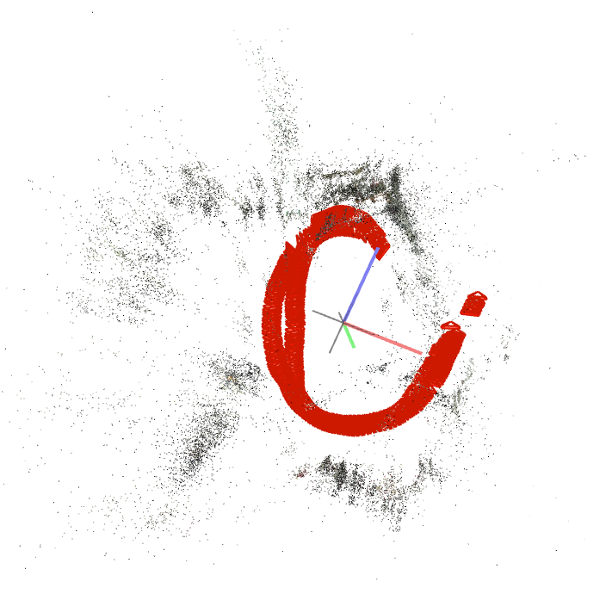
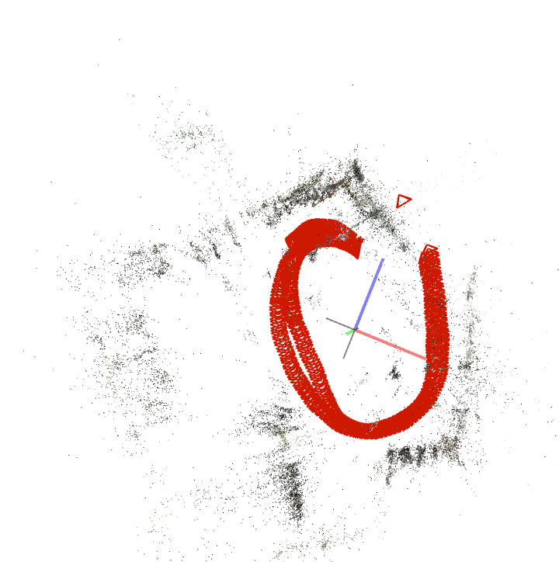
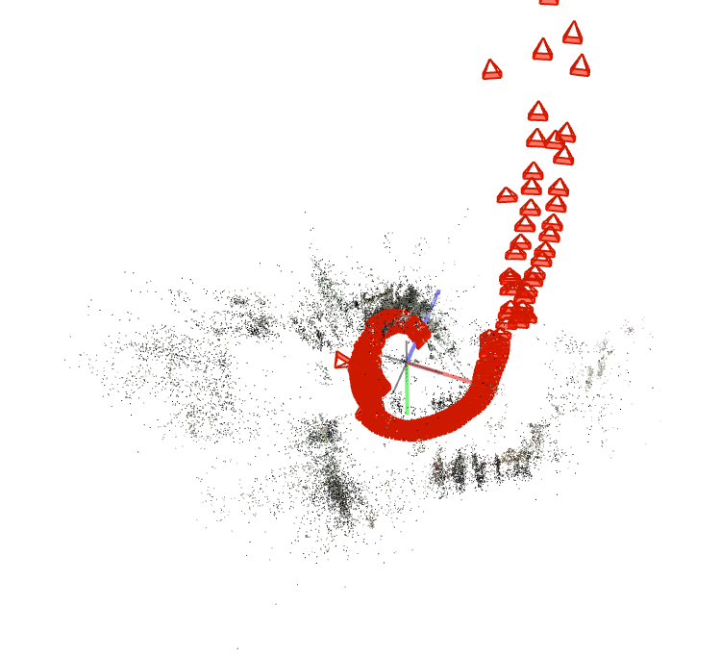
10 FPS 5.7K
SIMPLE_RADIAL_FISHEYE 1 Sparse model | SIMPLE_RADIAL Sparse model | RADIAL 1 Sparse model | FOV 3 Sparse models

Slide 6
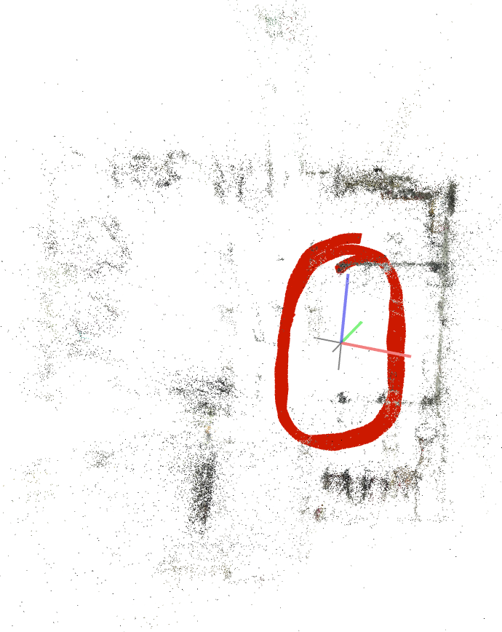
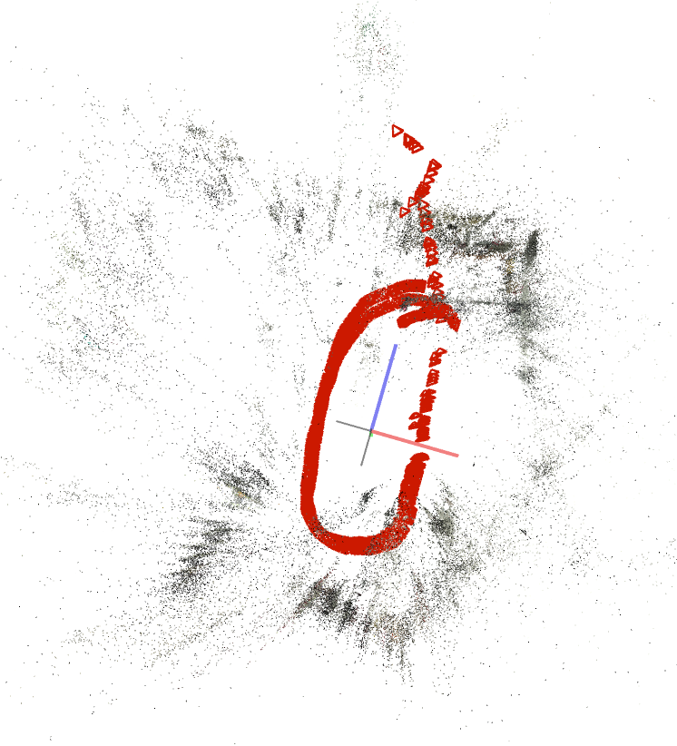
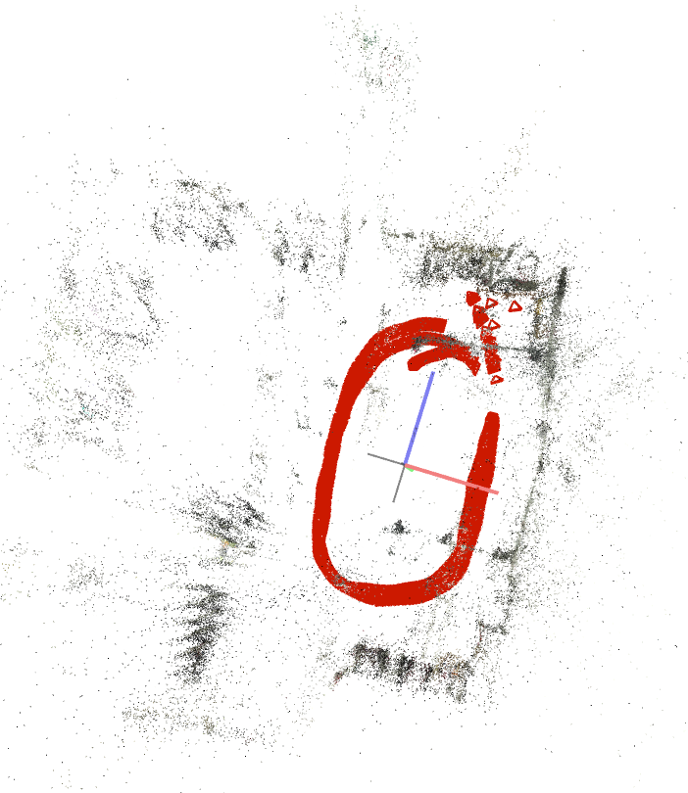
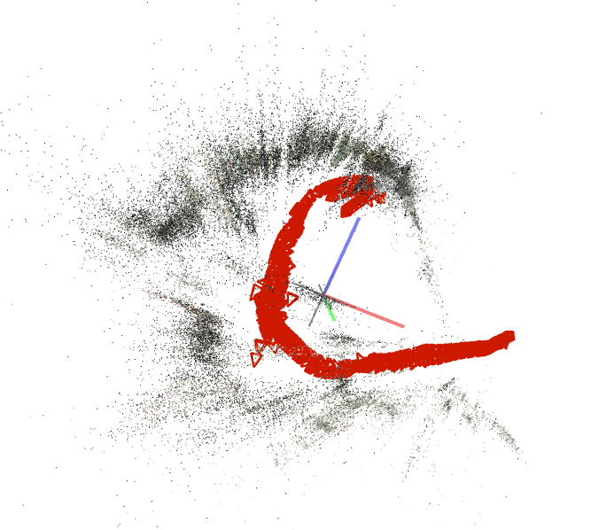
20 FPS 5K
SIMPLE_RADIAL_FISHEYE Sparse model | SIMPLE_RADIAL 1 Sparse model | RADIAL 1 Sparse model | FOV 1 Sparse model

Slide 7
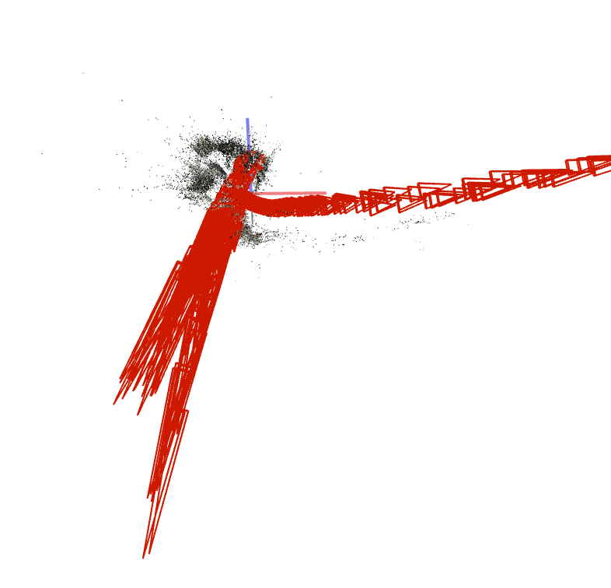
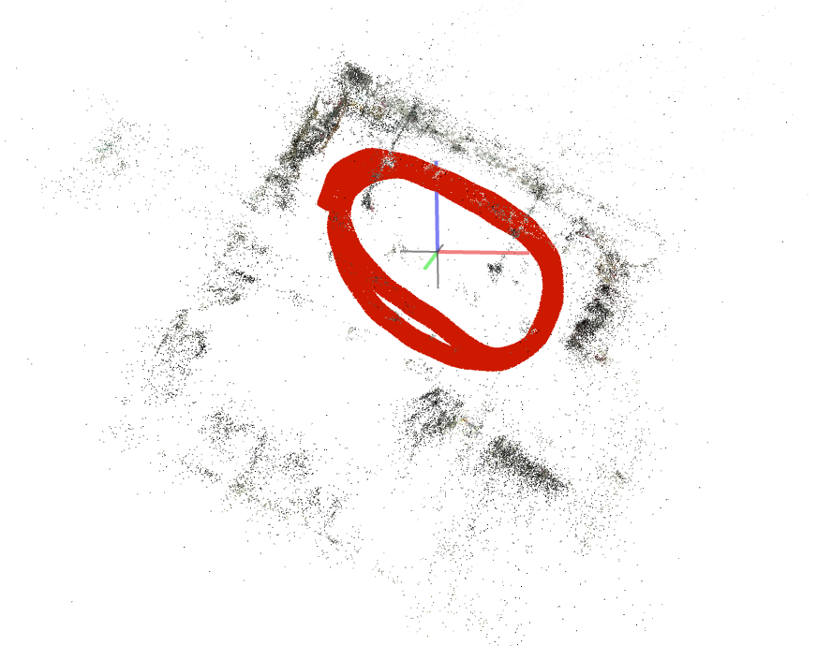
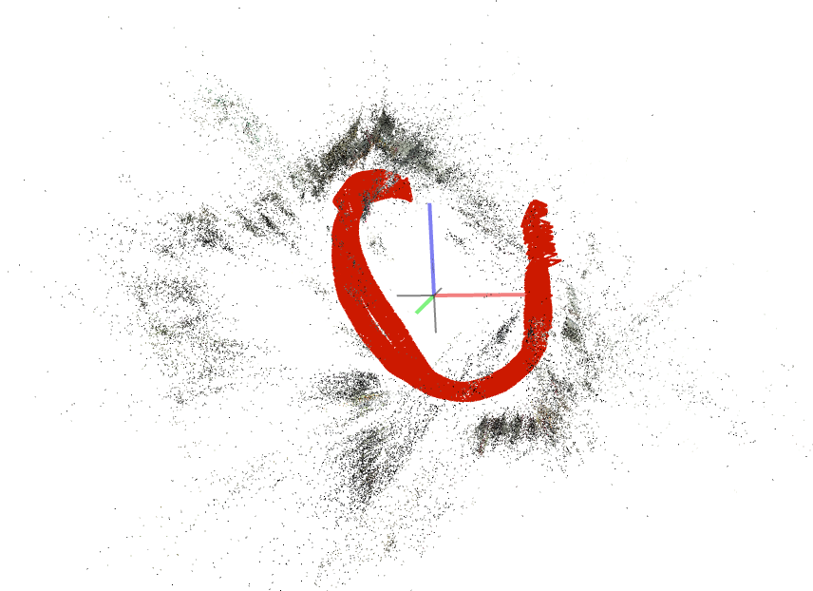
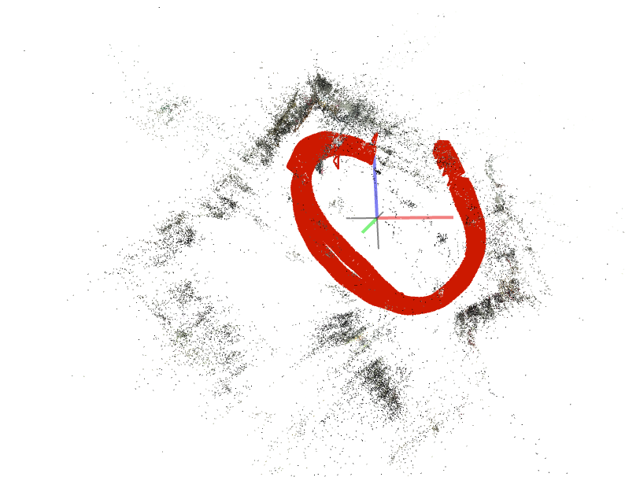
20 FPS 5.7K
SIMPLE_RADIAL_FISHEYE 1 Sparse model | SIMPLE_RADIAL 1 Sparse model | RADIAL 1 Sparse model | FOV 3 Sparse models

Slide 8
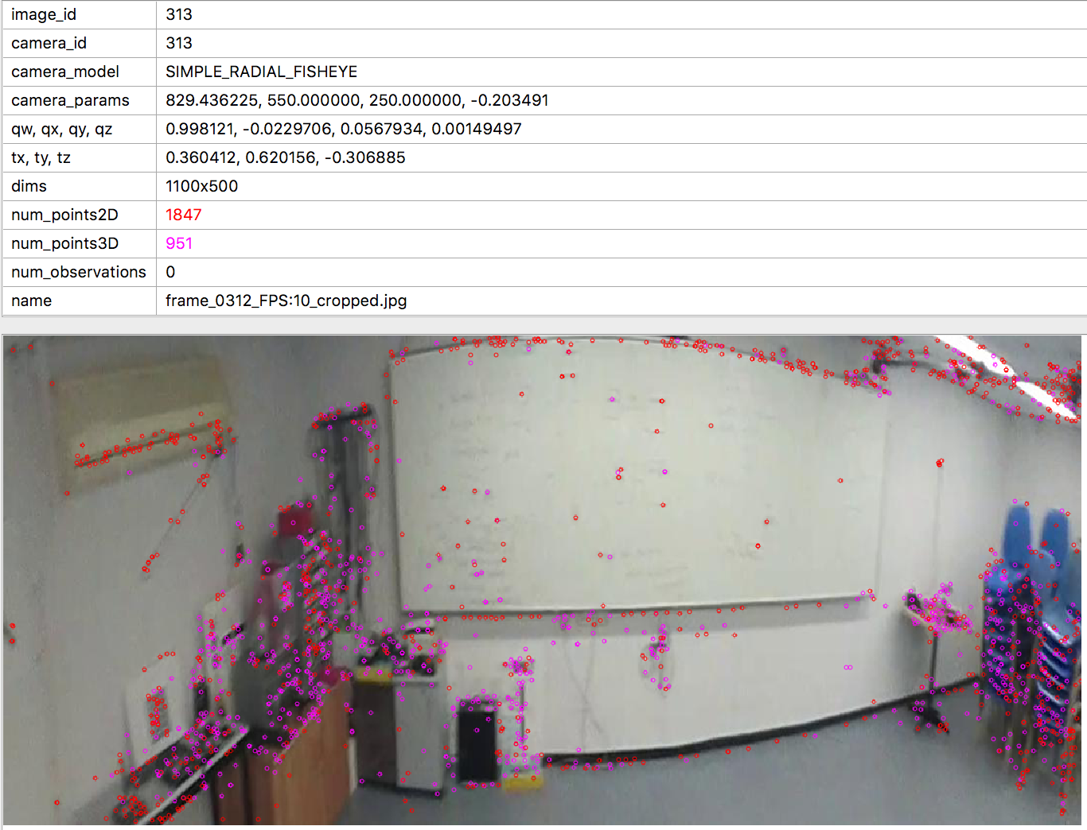
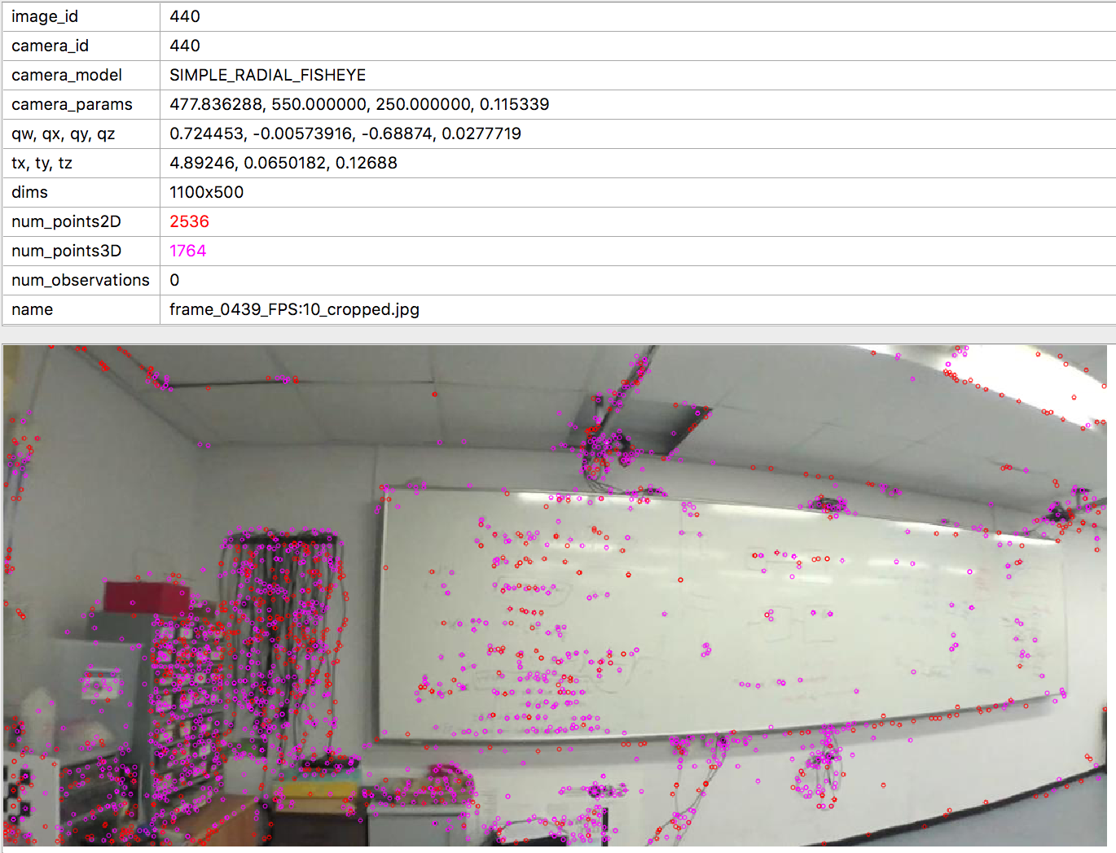
COMPARISON 4K/5K
4K
5K

Slide 9
CONCLUSION
Test for image stabilization

